Slide 1
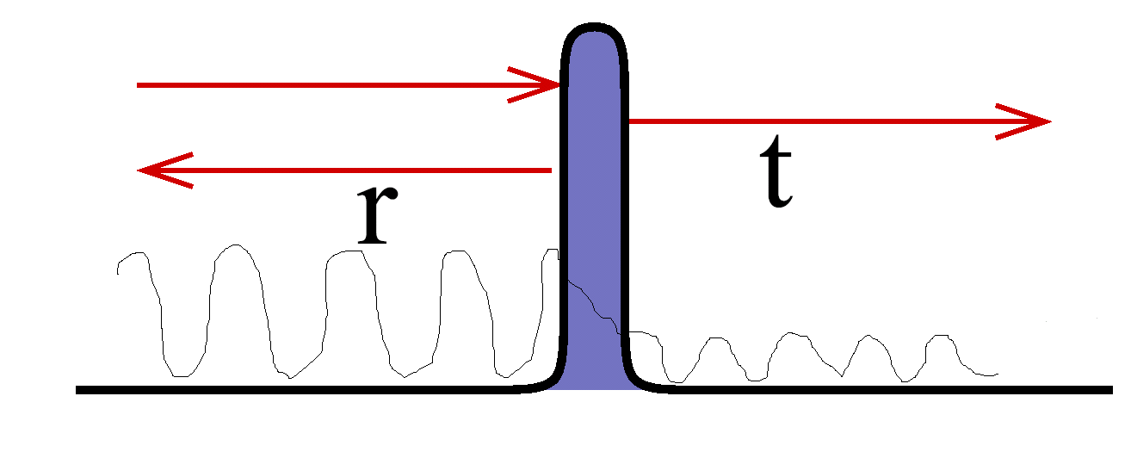
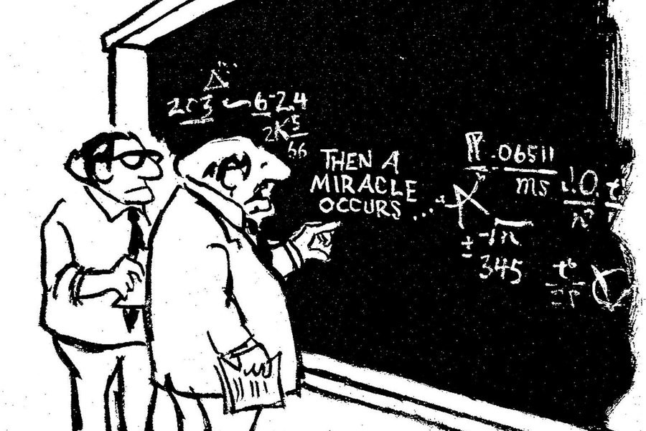
The Orthodox explanation of the measurement
A ONTIC 1D configuration space
The (orthodox) wave function is both transmitted and reflected simultaneously.
Electrons are transmitted or reflected, but not both !
Reflected electron:
Transmitted electron:
Electrons are transmitted or reflected, but not both !
The (orthodox) wave function is both transmitted and reflected simultaneously.
Notes:
Quantum noise is just the noise in devices where transport is due to quantum effects
Experimental set-up are not able to capture fast fluctuations and, in fact, what is measured is the power spectral density
Let us study a simple system: electrons tunelling in a barrier. Some transmitted some reflected
The wave function is transmitted or reflected, the particles are only transmitted or reflected.

Slide 2
A ONTIC 2D configuration space represented in a 1D “effective” space
The Bohmian explanation of the measurement (1)
The (conditional) wave functions are either transmitted or reflected, but not both!
Electrons are transmitted or reflected, but not both !
Reflected electron:
Transmitted electron:
The explanation on why electrons are transmitted or reflected does not need any “miracle”, just the solution of the Schrodinger equation in 2D sapce, including the measuring apparatus!
The (conditional) wave functions of the transmitted and reflected particles are different!
Notes:
Quantum noise is just the noise in devices where transport is due to quantum effects
Experimental set-up are not able to capture fast fluctuations and, in fact, what is measured is the power spectral density
Let us study a simple system: electrons tunelling in a barrier. Some transmitted some reflected
The wave function is transmitted or reflected, the particles are only transmitted or reflected.

Slide 3

The Bohmian explanation of the measurement (2)
The explanation on why electrons are transmitted or reflected does not need any “miracle”, just the solution of the Schrodinger equation, including the measuring apparatus!
We add one additional degree of freedom
that we called the pointer (2D Schrodinger equation)
A ONTIC 2D configuration space
The (conditional) wave function of the reflected particle
The (conditional) wave function of the transmitted particle
A 1D “effective” space
A 1D “effective” space

